Slide 1


Social
Buzz

Slide 2


Today's agenda
Project recap
Problem
The Analytics team
Process
Insights
Summary

Slide 3

Social Buzz is a fast growing technology unicorn that need to adapt quickly to it’s global scale.
Accenture has begun a 3 month POC focusing on these tasks:
• An audit of Social Buzz's big data practice.
• Recommendations for a successful IPO.
• Analysis to find Social Buzz's top 5 most popular categories of content.
Project Recap

Slide 4

Problem
Over 100000 posts per day
36,500,000 pieces of content
per year!
But how to capitalize on it when there is so much?
Analysis to find Social Buzz's top 5 most popular categories of content

Slide 5



Sara Rashford
Chief Technical Architect
The Analytics team
Marcus Vetri
Senior Principle
Satyajit Chavan
Data Analyst

Slide 6

Process
1
Data Understanding
2
Data Cleaning
3
Data Modelling
4
Data Analysis
5
Uncover Insights

Slide 7

Insights
16
UNIQUE
CATEGORIES
ANIMAL
MOST FAVORITE
CATEGORY
MAY
MONTH WITH MOST
NUMBER OF POSTS

Slide 8
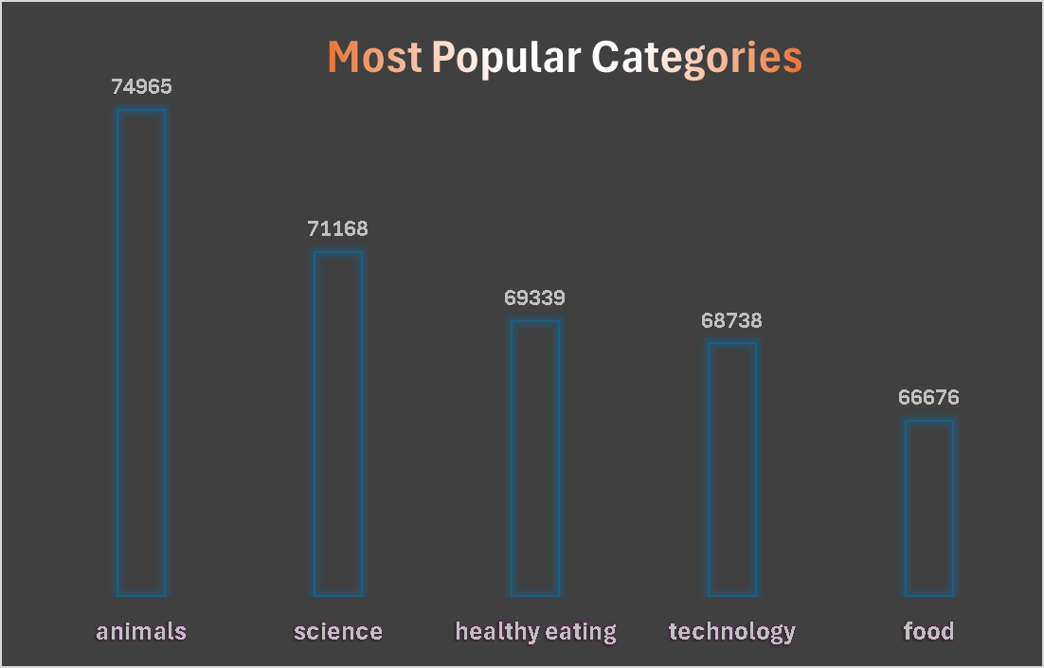

Slide 9
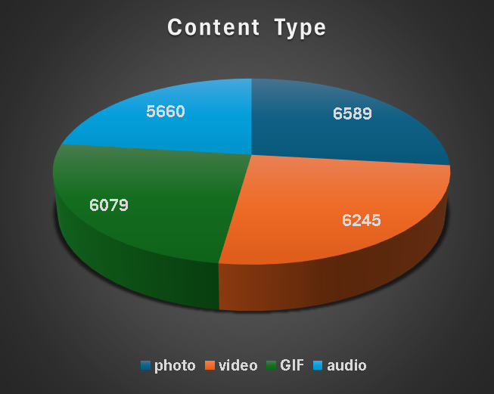

Slide 10
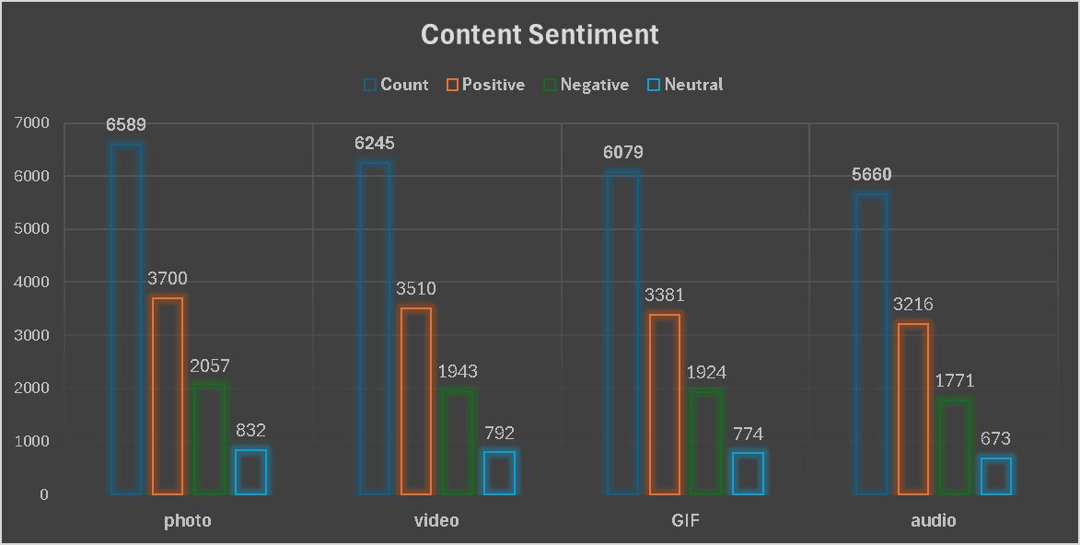

Slide 11

Insights :
There are 16 distinct categories, with Animal and Science being the most popular.
The platform supports 4 content types: Photo, Video, GIF, and Audio.
May consistently sees the highest number of posts, indicating increased activity or engagement during that month.
Summary
Conclusion :
Need to focus more on top 5 categories that’s Animal, Science, Technology, Food And Healthy Eating.
Create Campaign to Specifically Target Those Audiences.
Need to maximize efforts in January, May and August for more Activity.

Slide 12
Thank you!

